Slide 1
Packaging & 3D Integration
Month 00, 0000
Presenter Name [Optional]
Title [Optional]

Slide 2
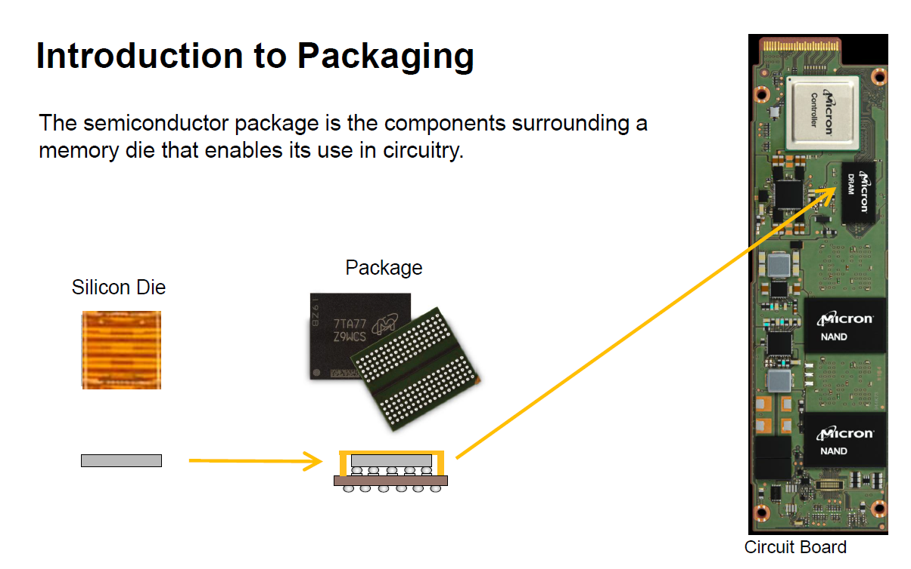
https://www.micron.com/educatorhub/courses/intro-to-memory-packaging

Slide 3
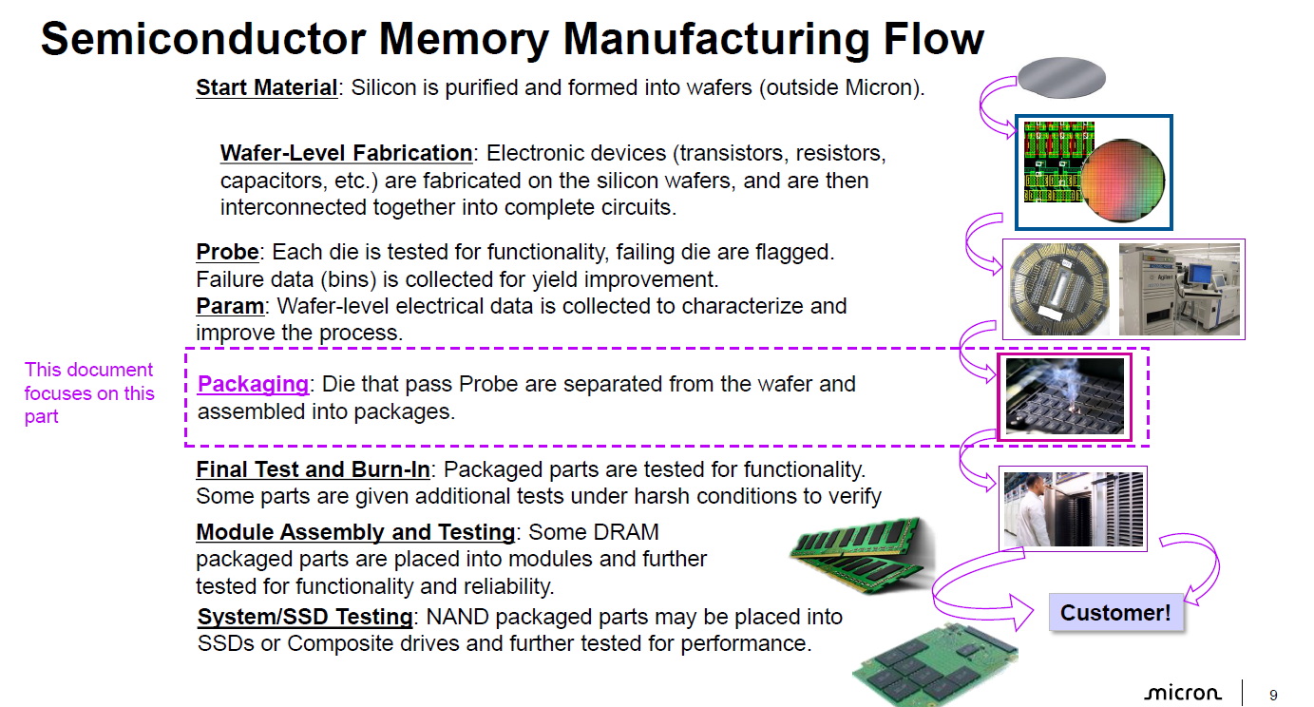

Introduction to Packaging
https://www.micron.com/educatorhub/courses/intro-to-memory-packaging

Slide 4
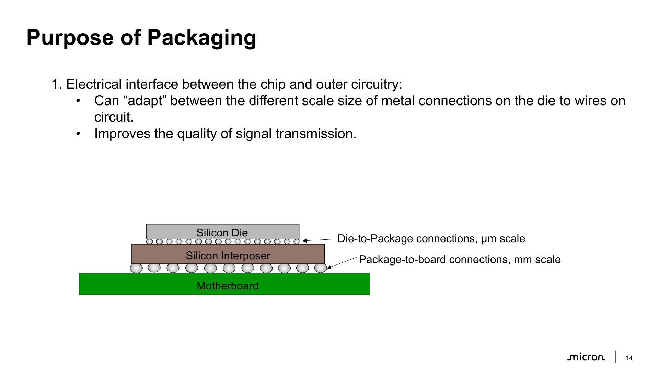
https://www.micron.com/educatorhub/courses/intro-to-memory-packaging

Slide 5
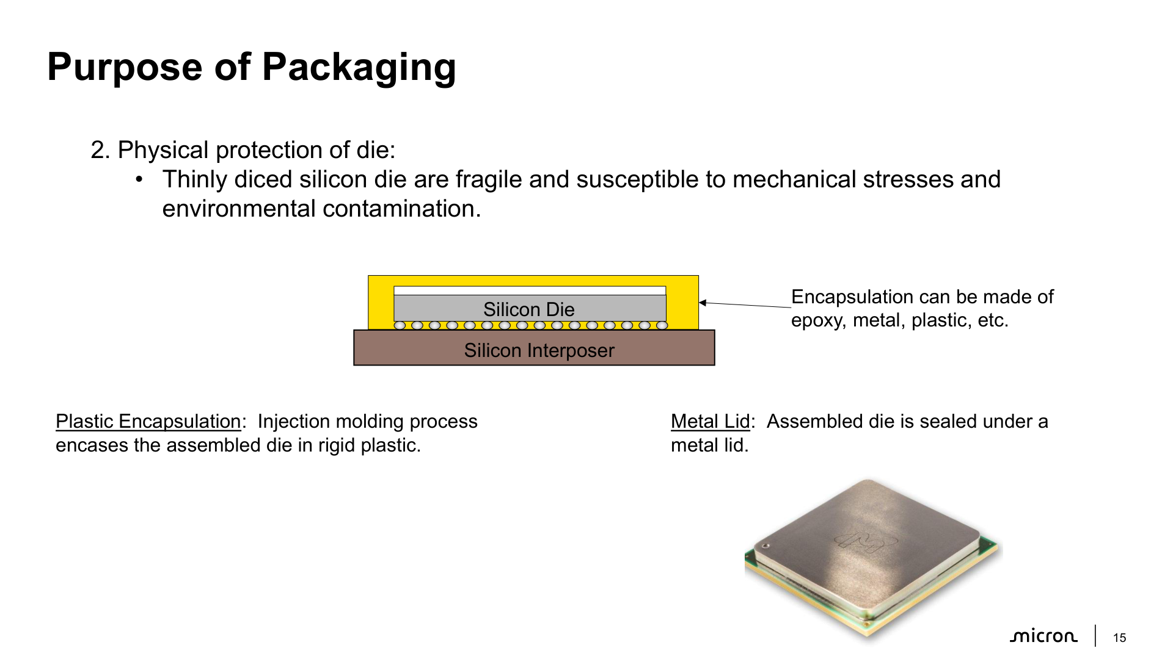
https://www.micron.com/educatorhub/courses/intro-to-memory-packaging

Slide 6
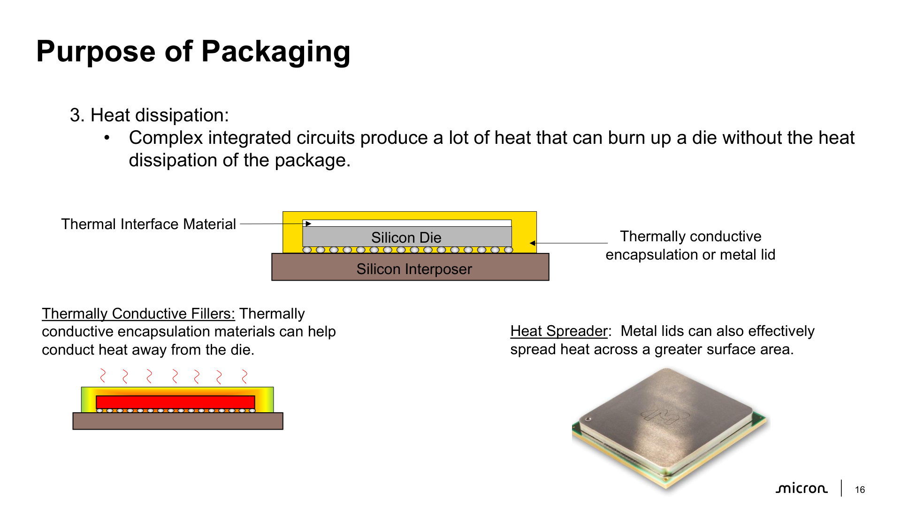
https://www.micron.com/educatorhub/courses/intro-to-memory-packaging

Slide 7
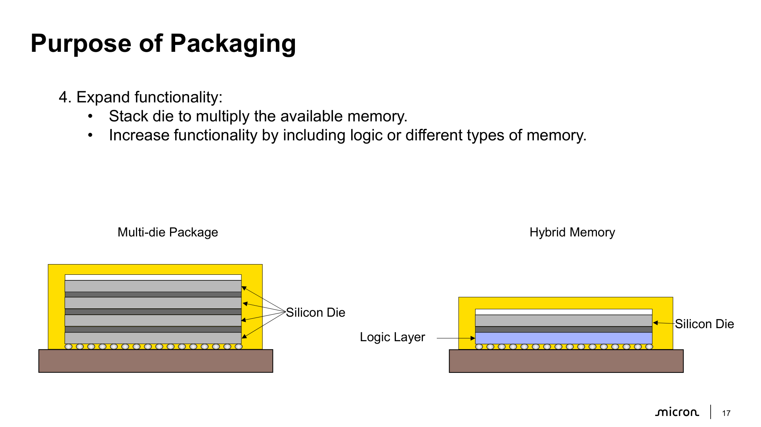
https://www.micron.com/educatorhub/courses/intro-to-memory-packaging

Slide 8
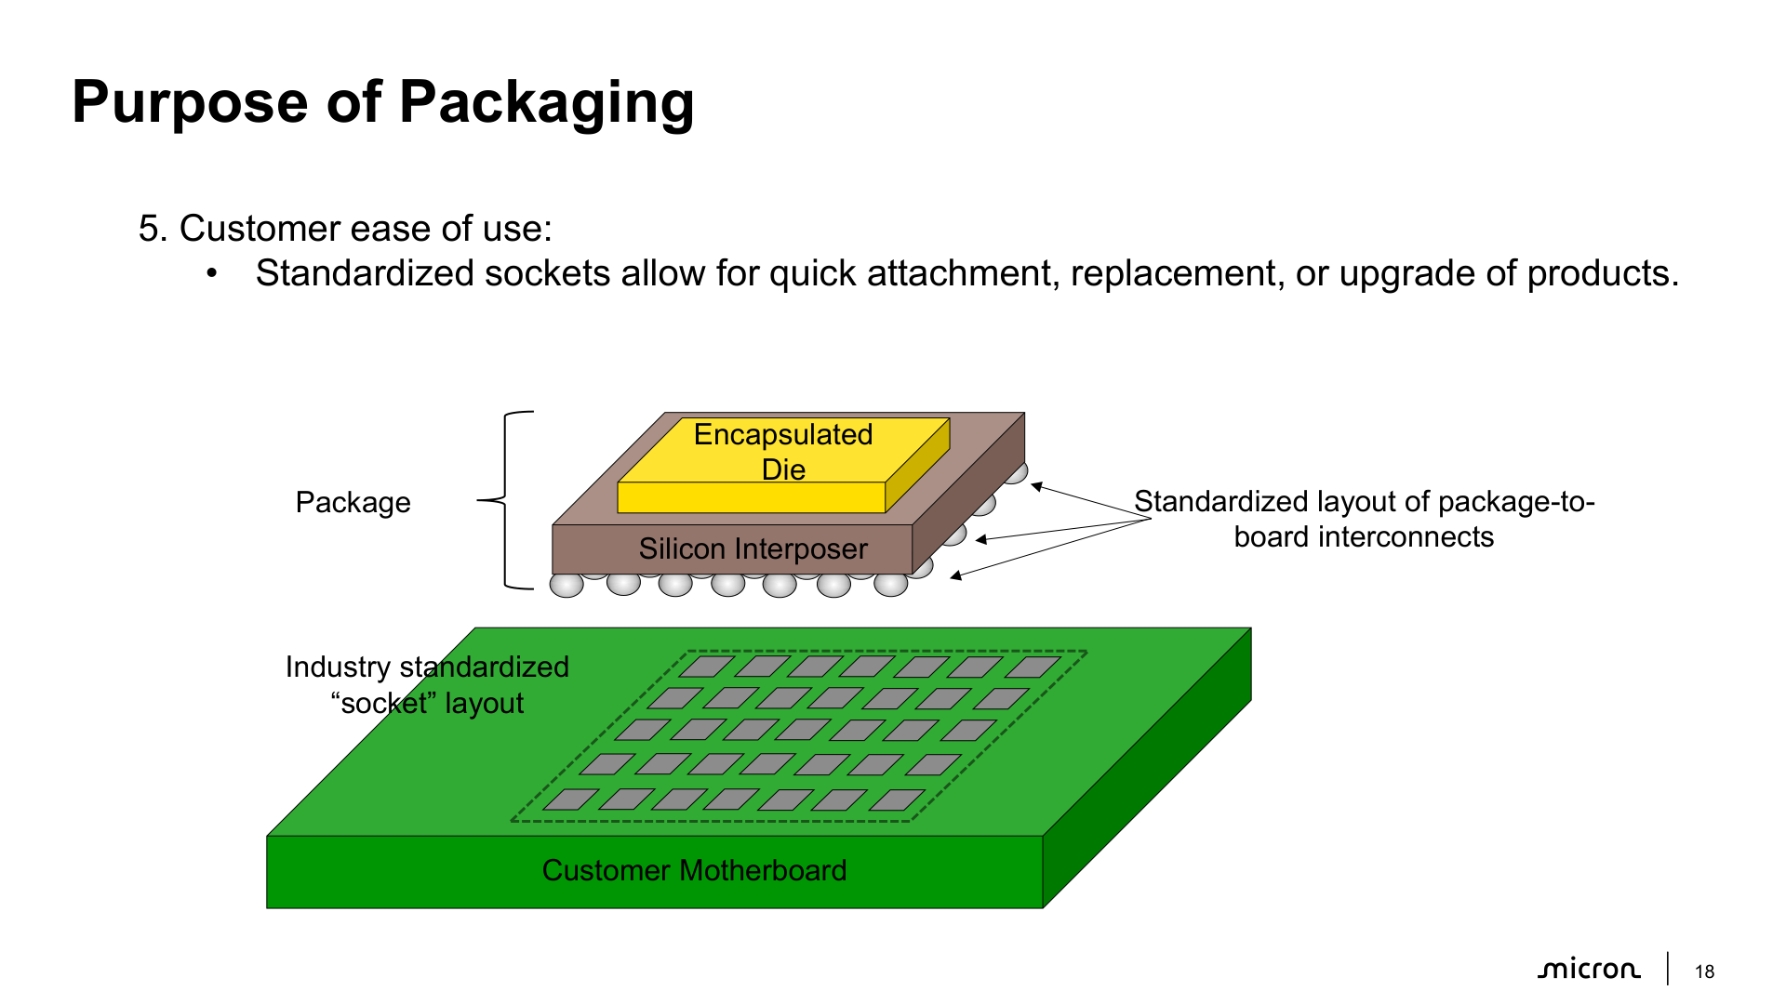
https://www.micron.com/educatorhub/courses/intro-to-memory-packaging

Slide 9
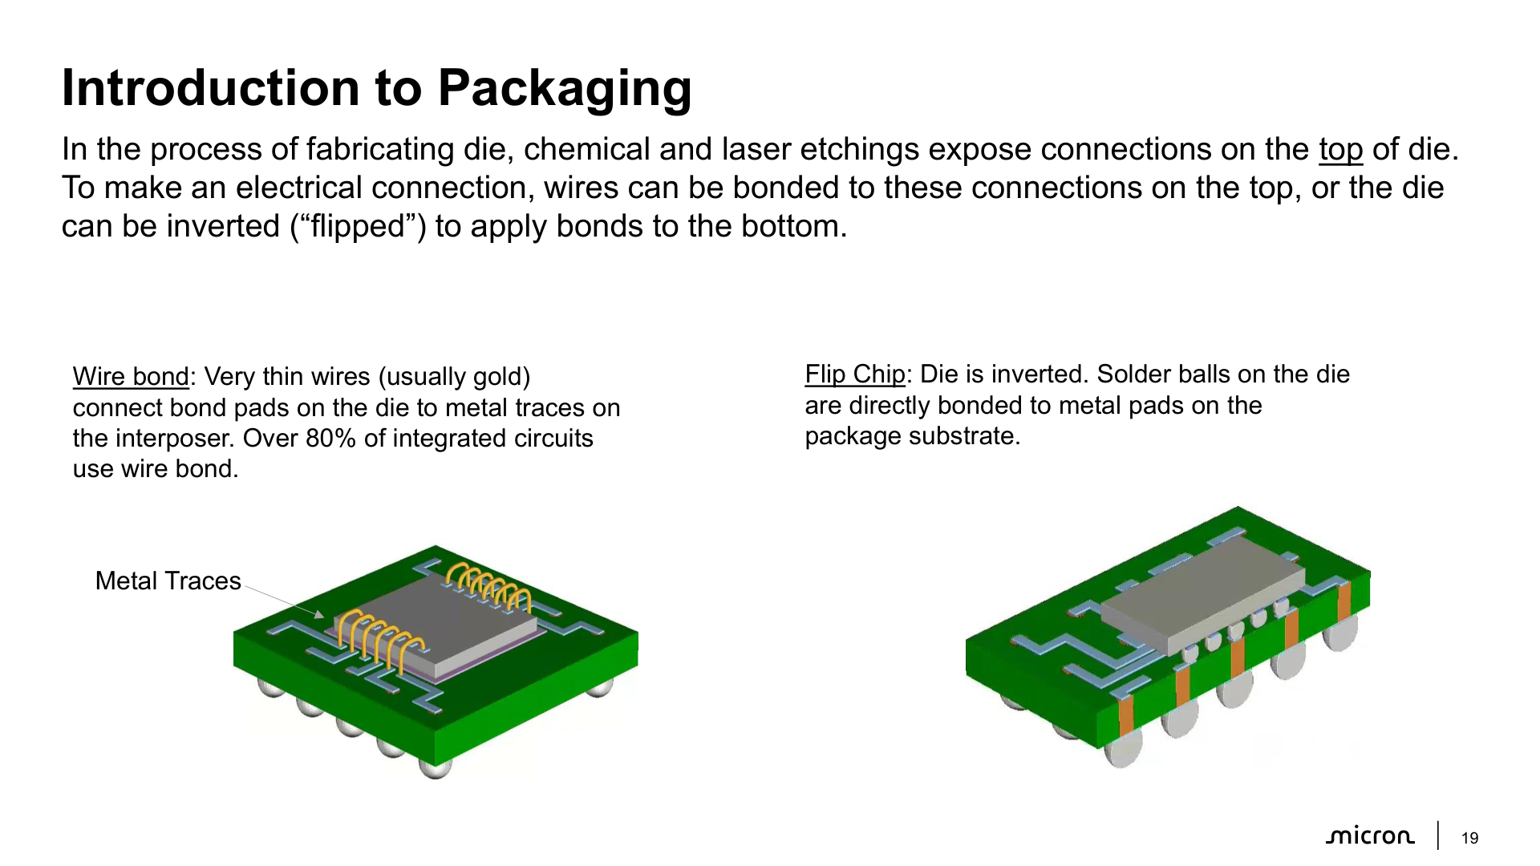
https://www.micron.com/educatorhub/courses/intro-to-memory-packaging

Slide 10
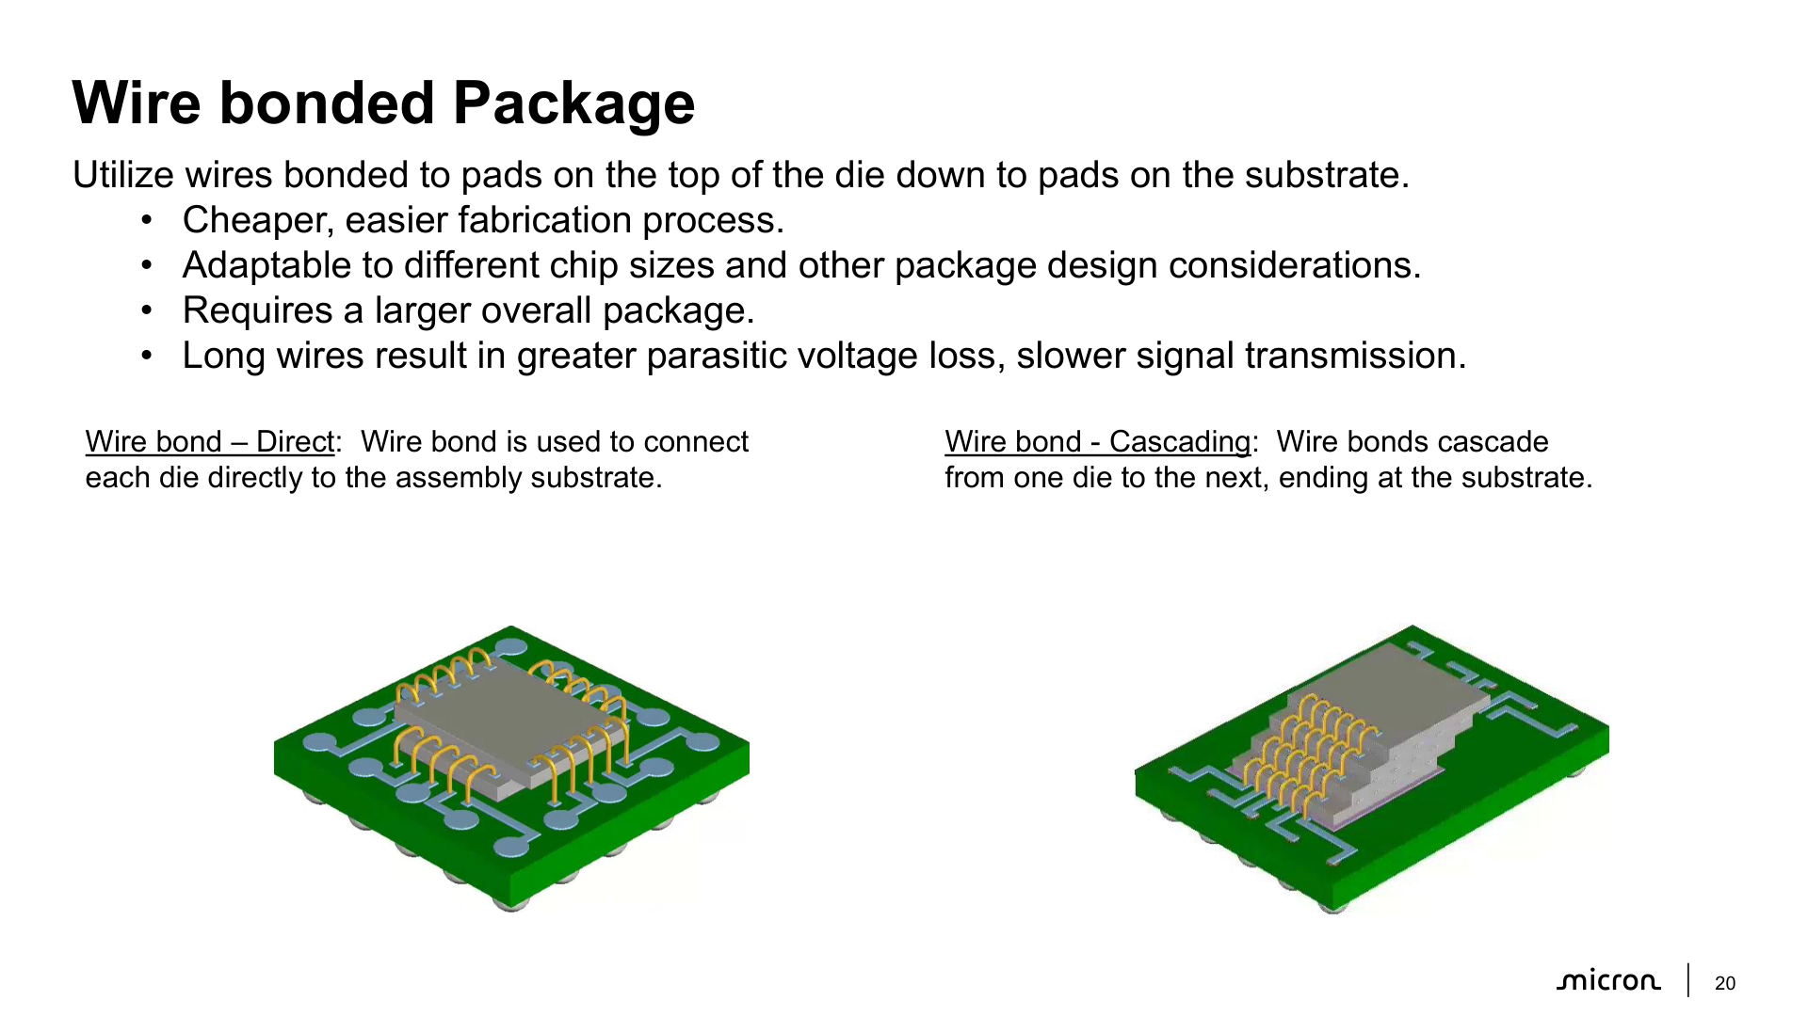
https://www.micron.com/educatorhub/courses/intro-to-memory-packaging

Slide 11
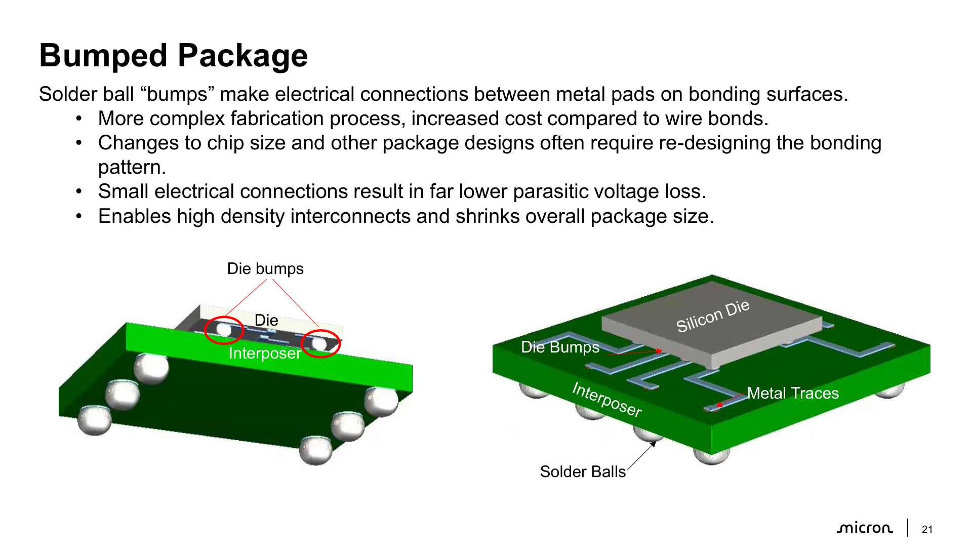
https://www.micron.com/educatorhub/courses/intro-to-memory-packaging

Slide 12
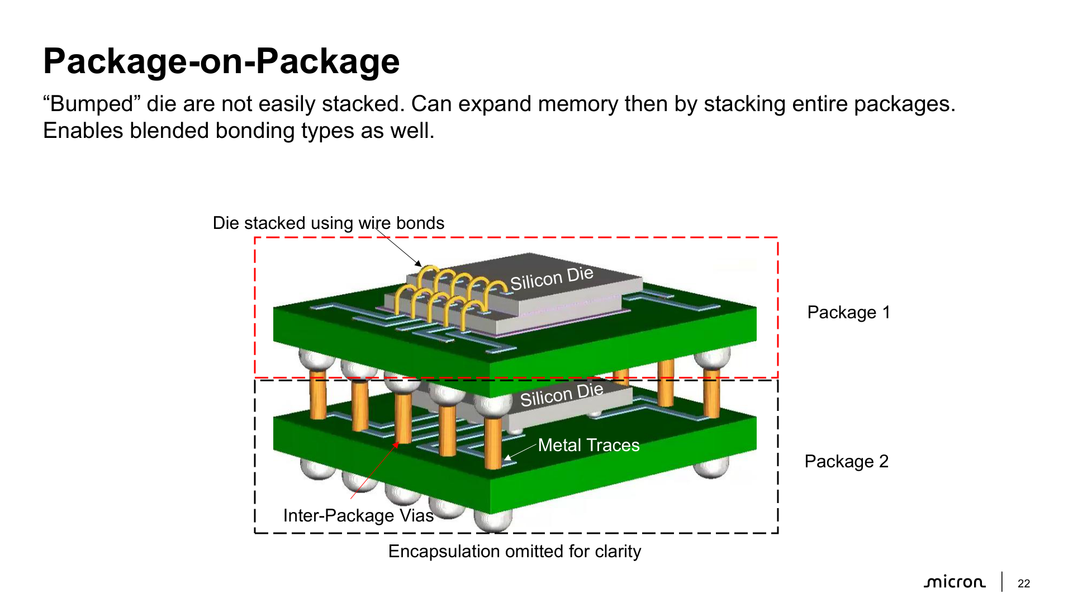
https://www.micron.com/educatorhub/courses/intro-to-memory-packaging

Slide 13
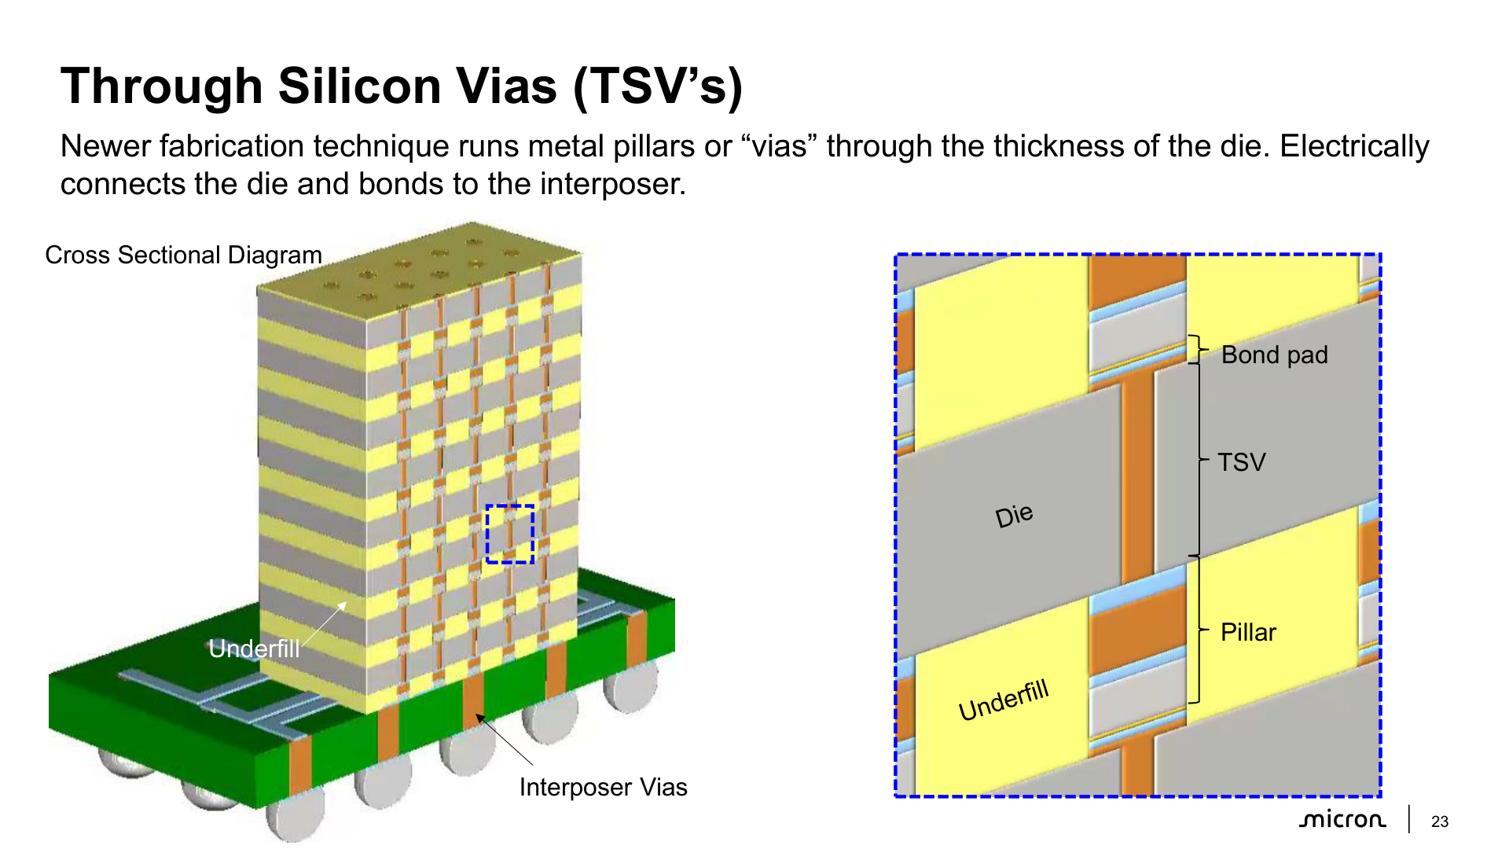
https://www.micron.com/educatorhub/courses/intro-to-memory-packaging

Slide 14
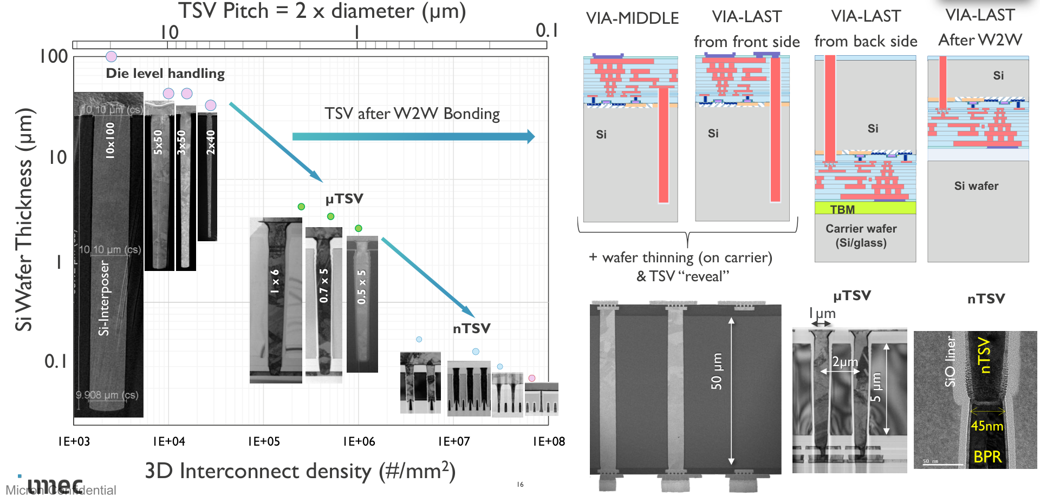
TSV scaling

Slide 15
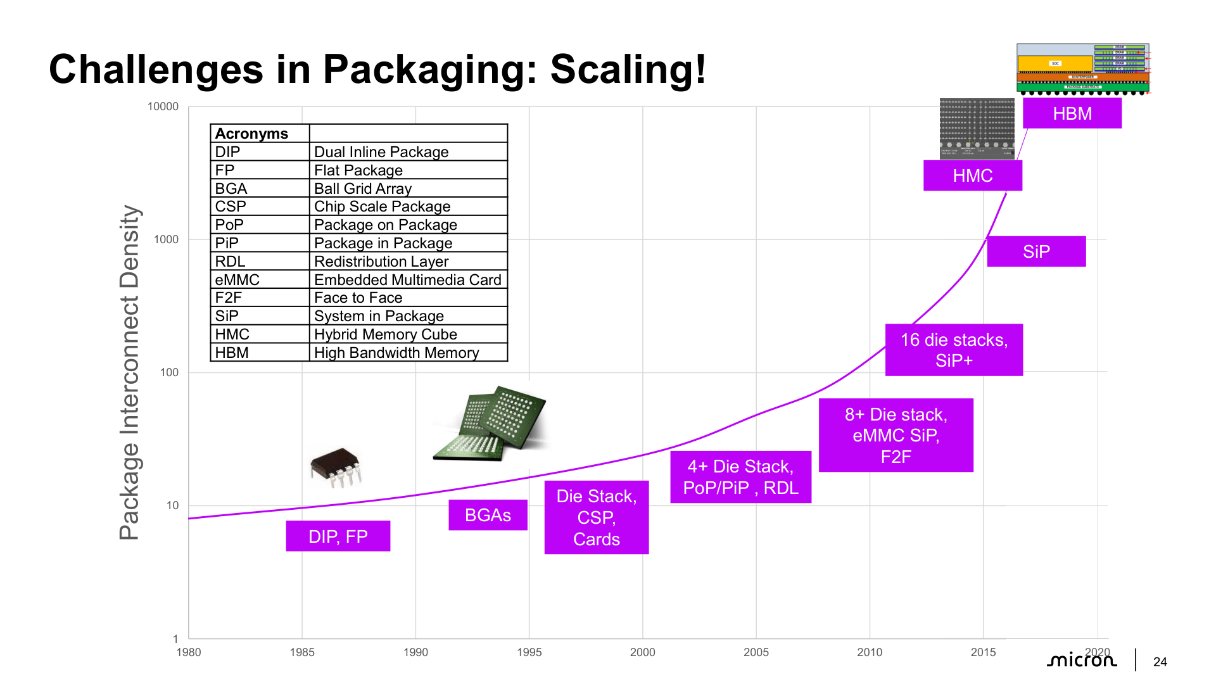
https://www.micron.com/educatorhub/courses/intro-to-memory-packaging

Slide 16
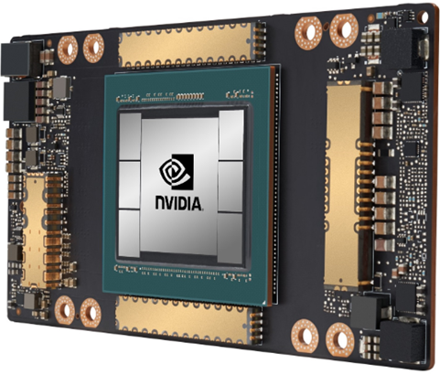
HBM Architecture
GPU
HBM Cube
GPU
8 Core die
(DRAM)
TSVs
Micro-bump
3D Engine/ Display Ctl
HBM Memory Controller
HBM PHY
Logic die
Si Interposer
8x Native Channels
IEEE1500
C4 bump
PKG substrate
GPU Interface
JTAG Port
Power/Gnd
DA Port
The HBM Memory is composed of a stack of DRAM memory die and a Logic die (also referred to as Interface die)
These are interconnected with TSV’s.
The Interface die interfaces to the external system.
A channel provides access to a discrete pool of memory.
GPU and HBM cube are connected via Micro-Bump.
HBMs

Slide 17
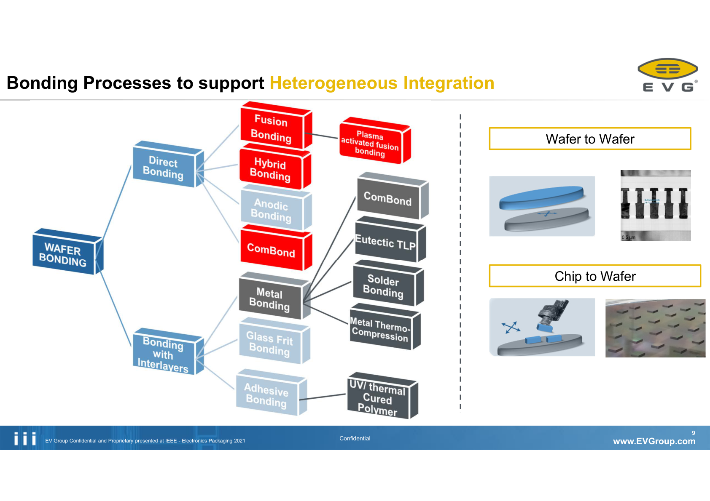
What’s next?
Die to wafer (hybrid) bonding
Wafer to wafer (hybrid) bonding

Slide 18
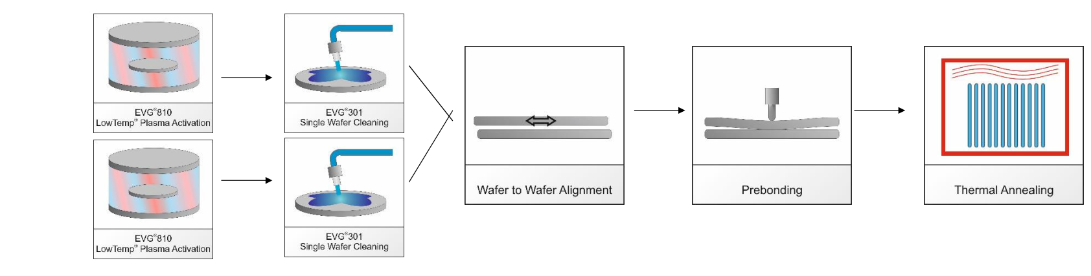
How bonding works

Slide 19
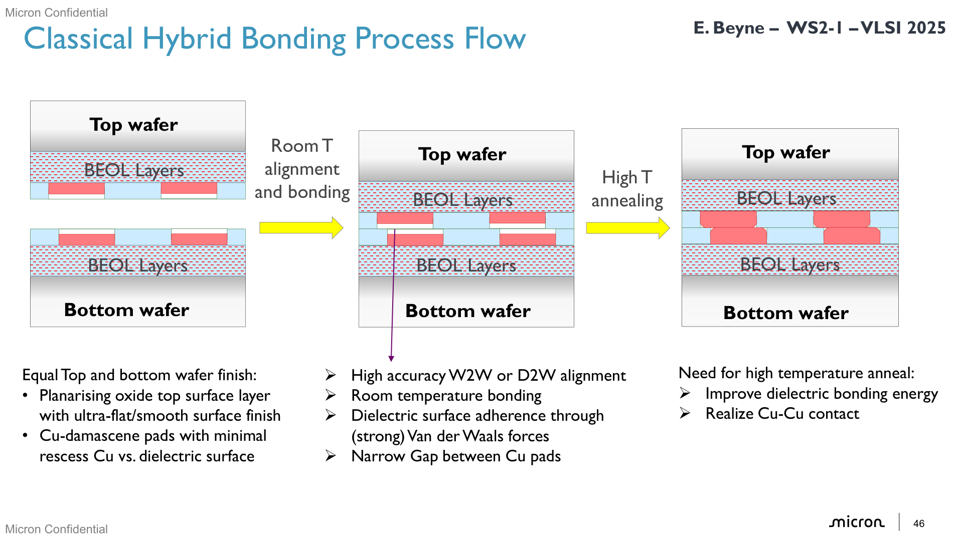
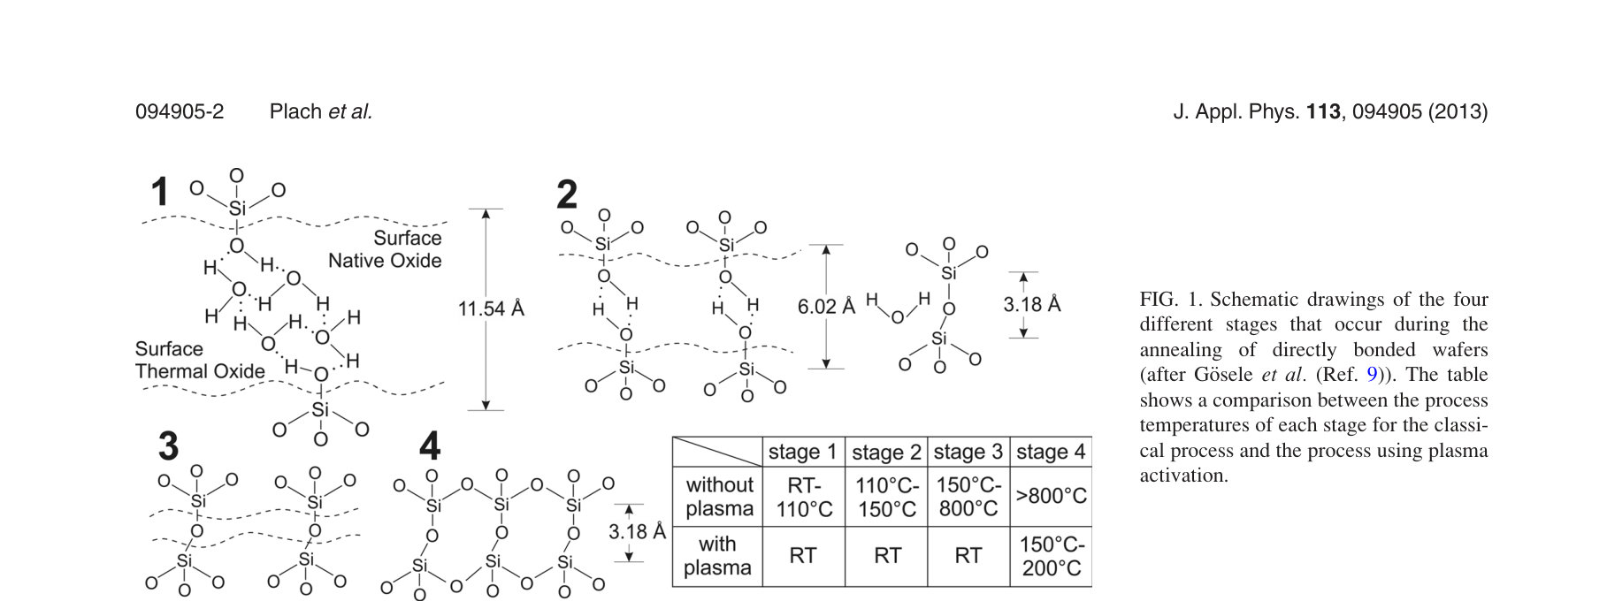
Fusion bonding
Bonding Mechanism (Hydrophilic Surfaces):
1. Surface Preparation:
• Wafers are cleaned and made hydrophilic (water-attracting)
• Surface terminated with silanol groups (Si-OH)
• 2-3 monolayers of water molecules adsorbed on surface
2. Initial Contact (Room Temperature):
• Wafers brought into contact at RT
• Van der Waals forces and hydrogen bonds form between:
- Water molecules on opposing surfaces
- Silanol (OH) groups across the interface
• Weak initial bond (~0.1 J/m²)
3. Bond Strengthening with Temperature:
Stage 1 (RT - 110°C): H-bond rearrangement
• Water molecules rearrange to maximize contact
• Slight increase in bond strength
Stage 2 (110°C - 150°C): Covalent bond formation
• Water diffuses out along interface and into bulk Si
• Silanol groups react to form covalent bonds:
Si-OH + HO-Si → Si-O-Si + H₂O
• Significant bond strength increase
Stage 3 (150°C - 800°C): Limited by roughness
• Most water removed, covalent bonds formed
• Bond strength limited by surface roughness
• Gaps remain where surfaces don't contact
Stage 4 (>800°C): Viscous flow
• SiO₂ softens and flows to close remaining gaps
• Maximum bond strength achieved (2.5 J/m²)
Silicon to silicon or dielectric to dielectric

Slide 20
Hybrid bonding
Dielectric + copper interconnect bonding

Slide 21
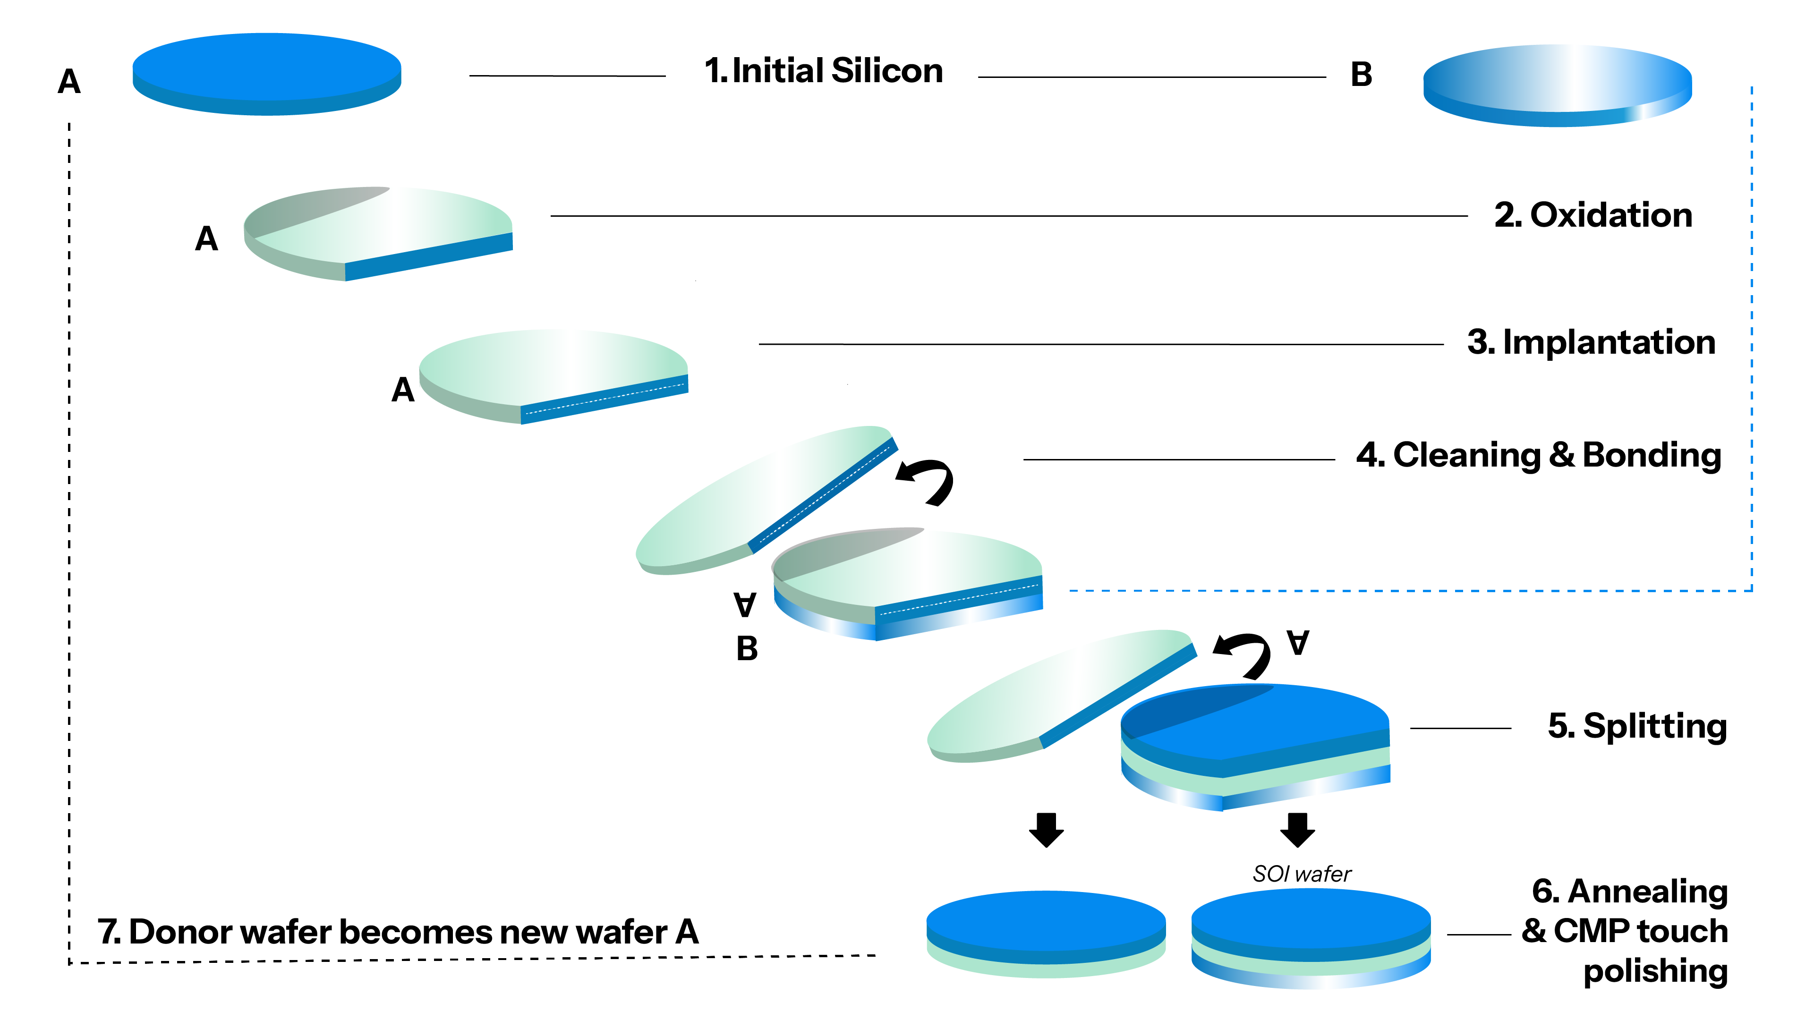
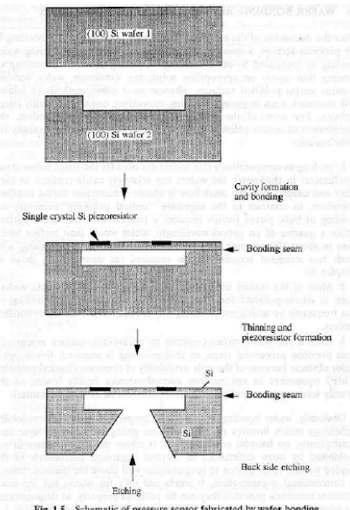
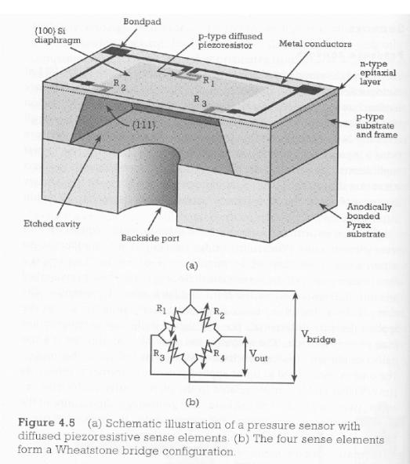
Fusion bonding: existing applications
Fusion bonding
SOI Wafers
MEMS
https://www.soitec.com/home/technology/innovation/smart-cut
https://sites.engineering.ucsb.edu/~sumita/courses/Courses/ME141B/ME141B_lecture_8_F10.pdf

Slide 22
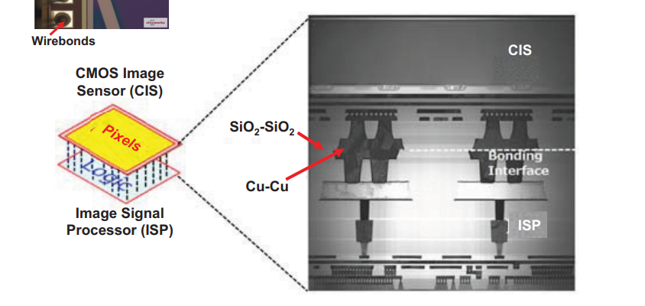
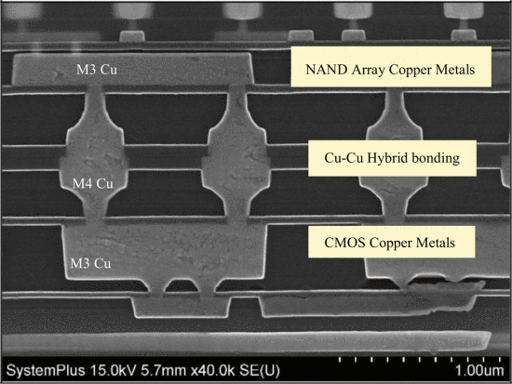
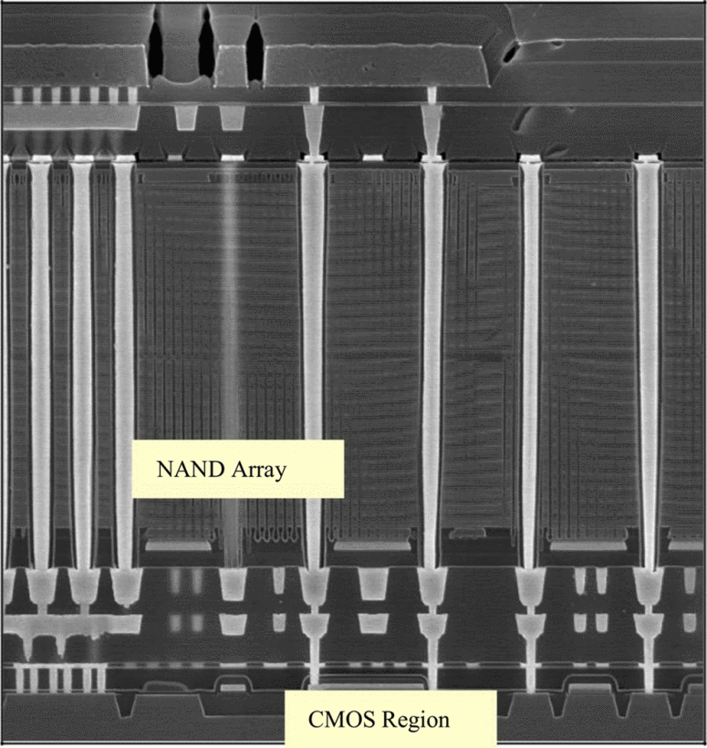
Hybrid bonding: existing applications
Fusion bonding
Backside illuminated image sensors
3D NAND Flash memories
Journal of Microelectronics and Electronic Packaging (2021) 18, 145–160
D. B. L. Yolanda, "Wafer to wafer bonding to increase memory density," 2022 China Semiconductor Technology International Conference (CSTIC), Shanghai, China, 2022, pp. 1-4

Slide 23
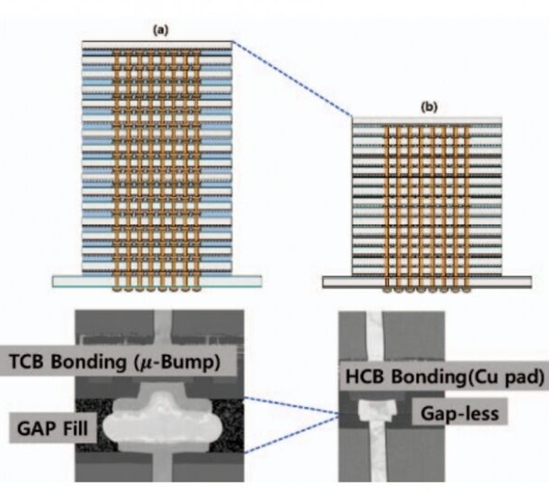
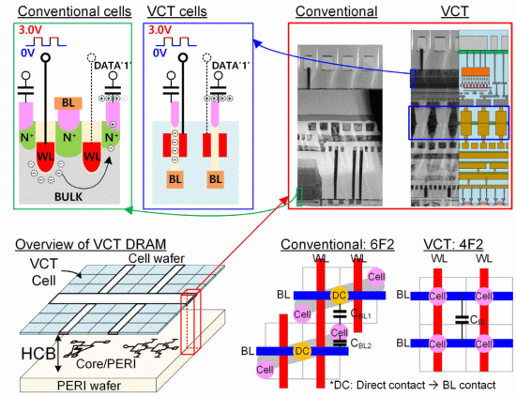
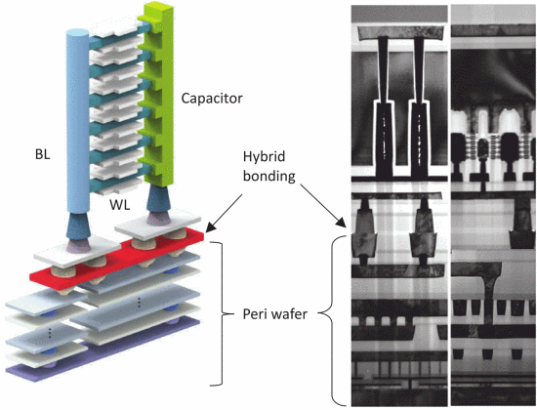
Fusion and hybrid bonding: perspectives
Memories
VCT DRAM
3D DRAM
HBM
H. Yoon et al., "15.10 A Vertical-Cell-Transistor-Based 4F2 DRAM with Cell-on-Peripheral Architecture Using Wafer-to-Wafer Hybrid Copper Bonding," 2026 IEEE International Solid-State Circuits Conference (ISSCC), San Francisco, CA, USA, 2026, pp. 272-274,
K. S. Choi et al., "A Three Dimensional DRAM (3D DRAM) Technology for the Next Decades," 2024 IEEE Symposium on VLSI Technology and Circuits (VLSI Technology and Circuits), Honolulu, HI, USA, 2024, pp. 1-2
H. Lee et al., "A study on D2W Hybrid Cu bonding Technology for HBM Multi-die Stacking," 2024 IEEE 74th Electronic Components and Technology Conference (ECTC), Denver, CO, USA, 2024, pp. 76-80,

Slide 24
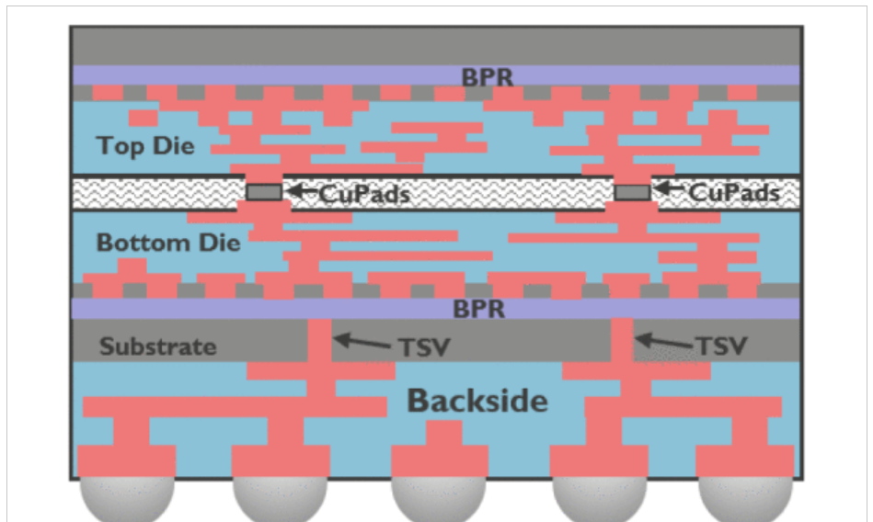
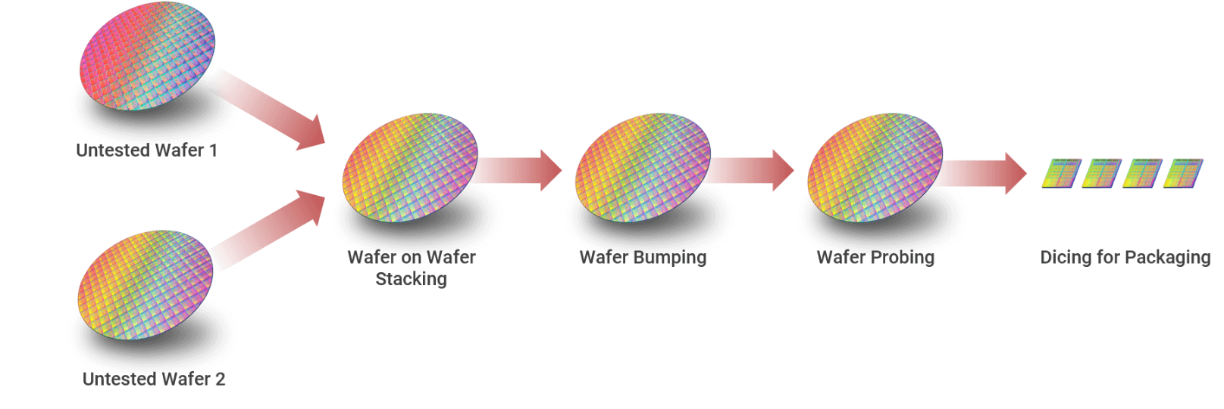
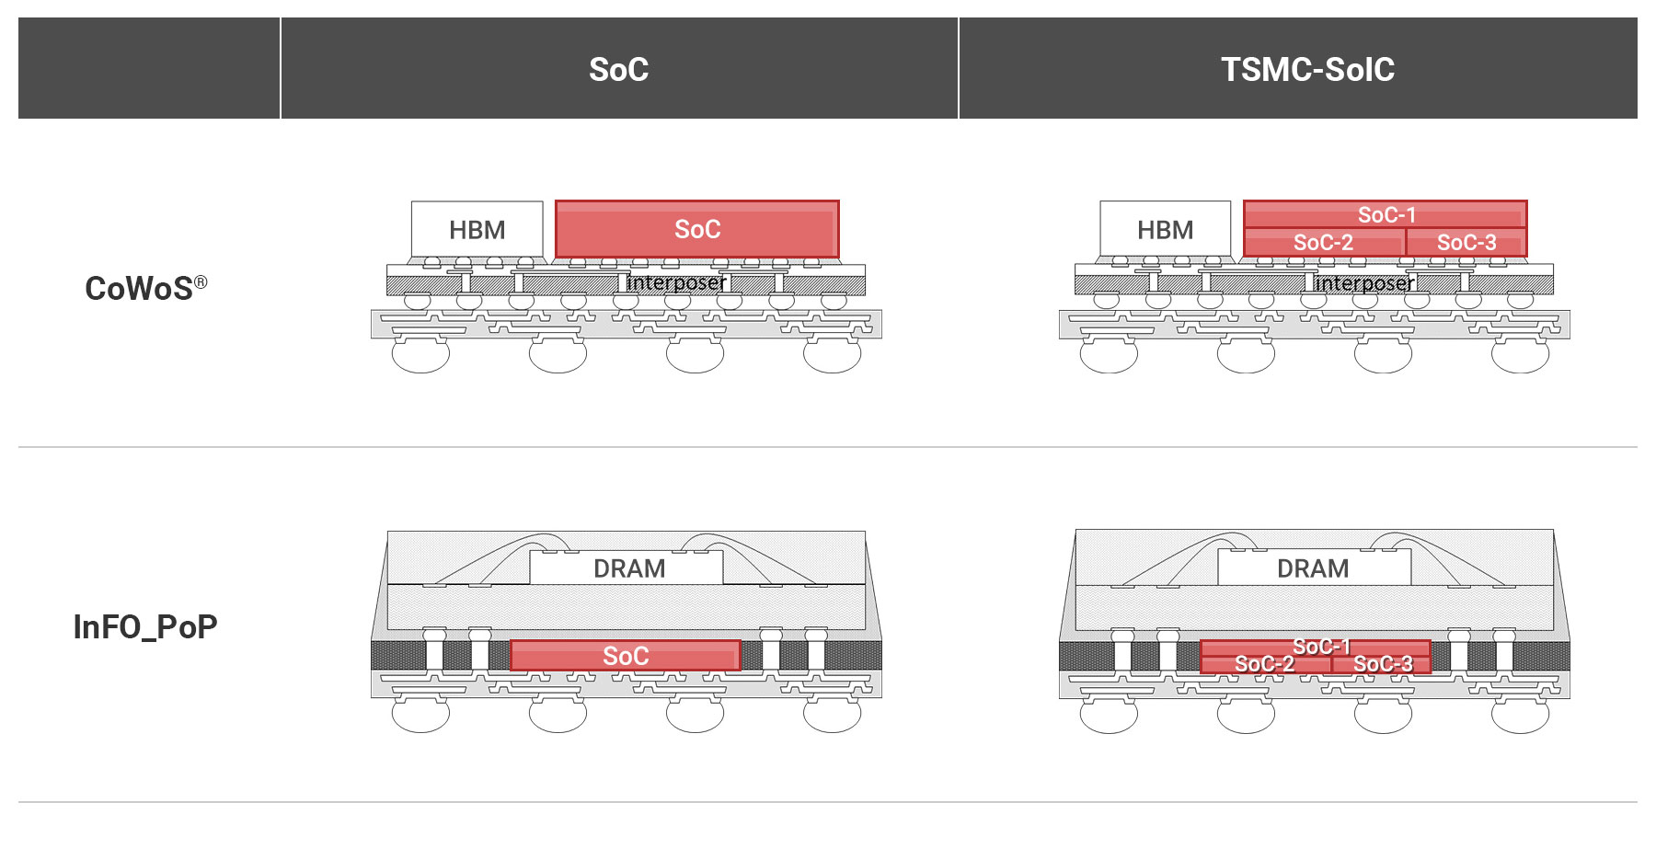
Fusion and hybrid bonding: perspectives
Logic
TSMC SoIC (both DoW and WoW)
Backside PDN
https://3dfabric.tsmc.com/english/dedicatedFoundry/technology/SoIC.htm#SoIC_WoW
https://3dfabric.tsmc.com/english/dedicatedFoundry/technology/SoIC.htm
G. Sisto et al., "IR-Drop Analysis of Hybrid Bonded 3D-ICs with Backside Power Delivery and μ- & n- TSVs," 2021 IEEE International Interconnect Technology Conference (IITC), Kyoto, Japan, 2021, pp. 1-3

Slide 25
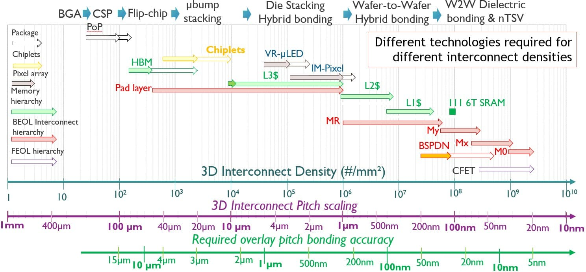
A 3D Interconnect roadmap
https://www.imec-int.com/en/articles/path-high-density-front-and-backside-wafer-connectivity

Slide 26
Metal Layer Designations (BEOL Interconnect Hierarchy)
Term | Meaning | Pitch Range | Notes
M0 | Metal 0 | ~20-50nm | Finest metal layer, closest to transistors (FEOL level). Used for local interconnects
Mx | Metal x (intermediate) | ~100-200nm | Intermediate BEOL layers for signal routing. Associated with BSPDN
My | Metal y (upper) | ~200-500nm | Upper BEOL routing layers
MR | Metal Redistribution | ~1-2um | Relaxed-pitch redistribution layer for connecting to packaging
"Mx, My and MR represent the BEOL interconnect hierarchy" - IMEC

Slide 27
Application / Use Case Abbreviations
Term | Meaning | Description
VR-uLED | VR micro-LED | Micro-LED pixel arrays for AR/VR displays
IM-Pixel | Image sensor Pixel | Camera/image sensor pixel interconnects
L3$ | Level 3 Cache | Third-level processor cache
L2$ | Level 2 Cache | Second-level processor cache
L1$ | Level 1 Cache | First-level processor cache (fastest, smallest)
III 6T SRAM | 6-Transistor SRAM | Standard 6-transistor SRAM cells at densest interconnect pitches

